Slide 1
Benefit 1:
Improved Security
Notes:
With any system involving payment and customer data, one of the biggest, if not the biggest, concern is security. With the increasing intelligence of hackers, the need for a secure system is imperative to a company’s success and the customer’s protection.

Slide 2
Improved Security
Current solutions are not advanced enough
60% of travel merchants felt fraud was a top issue when paying suppliers
Cost impact for OTA to Supplier is 6B in direct costs
Only 20-30% of transactions were being checked to catch fraud
- VP of eNett International
https://www.enett.com/insights/airline-failures-form
Notes:
However, after talking to a Sabre Virtual Payments senior manager and reading an interview by the VP of eNett International, we found that current solutions for security are not advanced enough, as ”fraudsters” are expected to easily break through this. 60% of 60% of travel merchants felt fraud was a top issue when paying suppliers, with the cost impact for OTA to Supplier being 6B in direct costs. Lastly, only 20-30% of transactions were being checked to catch fraud.
So the question becomes, how can we alleviate these problems? We believe blockchain is the answer.

Slide 3
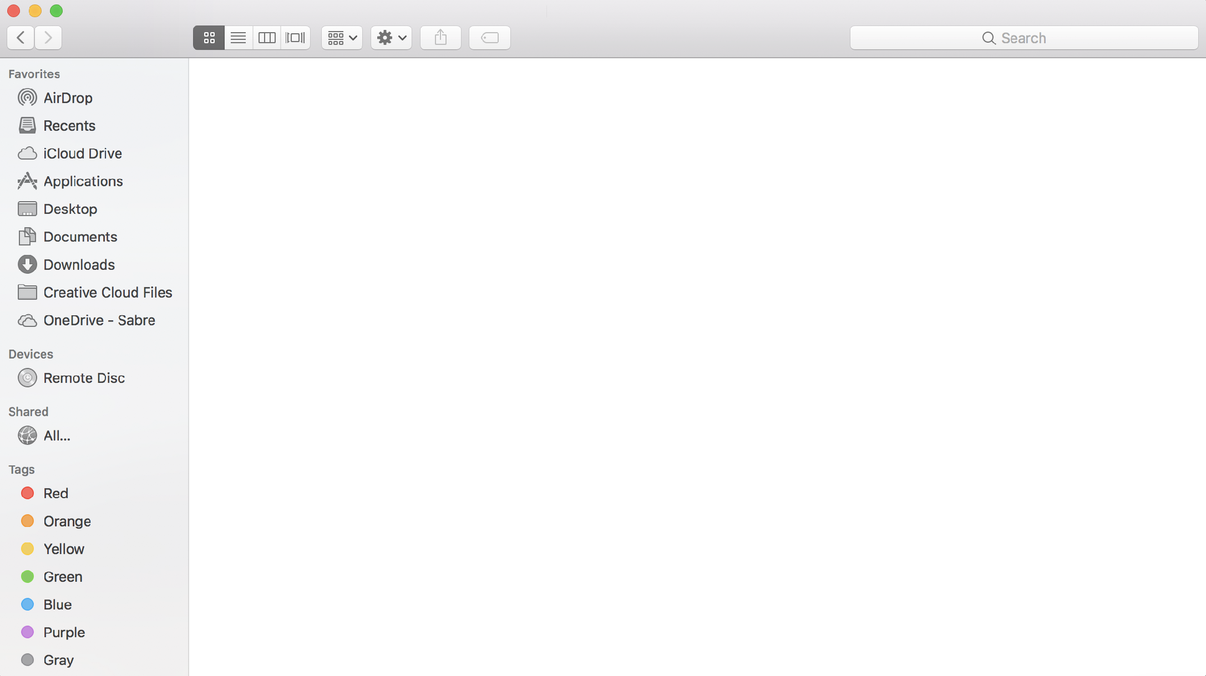
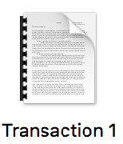
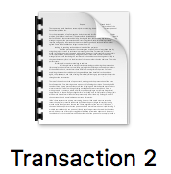
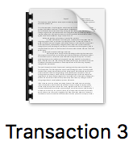



Blockchain Security Advantages
Timestamps
Encryption
Instant
Confirmation
Notes:
Blockchain can be a bit overwhelming for many people, and some of you might not have a clue what the heck it is. So briefly, I will explain the basic concept of it and reasons why it is so secure.
This is the mac file manager, which is just like the file manager on a Windows machine. It is where all your files are stored. So, I send Esteban (team member) 10 dollars. The transaction file is created and stored. I then send Natalie (team member) 10 dollars. The transaction file is created and stored. I send Luis (team member)10 dollars, the transaction file is created and stored.
Now, each of these transactions are timestamped, providing information of who, what, when, where, and how the transaction occurred. Each transaction is encrypted with AES encryption, which to date has not been able to be breached, and each transaction is instant and confirmed.

Slide 4

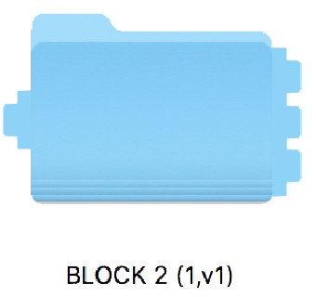
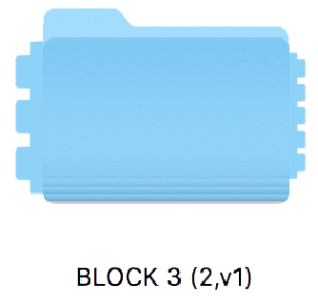
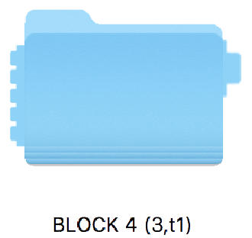

Blockchain Security Advantages
Notes:
Now for this example, let’s say that only 3 transactions can be held by a folder. Well, then a folder would be created. Now each created folder has a unique connector that is created with it. I conduct three more transactions, and another folder would be created. This folder not only creates a unique connector, but also contains the connector of the previous folder, which makes them match. I conduct more transactions and more folders are created. As you can see, each folder matches and connects with the previous one.
However, let’s say that Esteban tries to alter a transaction between he and I, and tries to make my account send 50 dollars instead of 10.

Slide 5

Blockchain Security Advantages
Chain is now broken and shorter
Break shows someone has tried to tamper file
Notes:
The connector of the folder holding that transaction would change and create a different unique shape. Why is this? Well, each time information is altered in the folder, a unique connector is regenerated.
But if this occurs, then the chain would break, as the next folder no longer contains the previous folder’s connector. The chain now is broken and shorter and thus shows that someone tried to tamper with the file.

Slide 6
Blockchain Security Advantages
Constant synchronization
One open ledger for all parties
Can set permissions
Notes:
As well as the chain structure, the blockchain also is decentralized, meaning you don’t have to rely on one server and/or one party controlling all of the information. With blockchain, thousands and thousands of computers are powering the blockchain. This means that a hacker would have to hack all the computers at the same time instead of just one single server.
Each of these computers are being constantly synced up.
Another advantage with this is that there is one ledger for all the parties involved. Esteban and I are using one ledger to record the transactions instead of he using his own ledger and I using my own ledger, and these ledgers can be set to have permissions on who exactly can see everything.

Slide 7
Improved Security
-Immutable
-Decentralized
-Encrypted
-Verification
-Instant
Notes:
To summarize, blockchain provides, among many others, five key advantages for security: immutability, decentralization, encryption, verification, and instantaneous payment settlement.

Slide 8
Appendix
Notes:
Restructure:
Team Intro
problem statement, HAVE NUMBERS
--------------GETTHERE
SOLUTION----SABREPAY-----BENEFITS
blockchain 101
blockchain benefits (security, fraud)
B2B payment
currect state vs. future
finance
implementation
ONLY 3 PHASES NOW

Slide 9
Benefit 2 (In Depth):
Improved Security

Slide 10
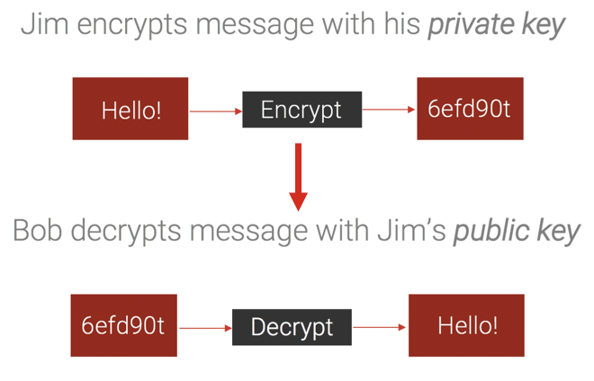
Digital Signatures

Slide 11
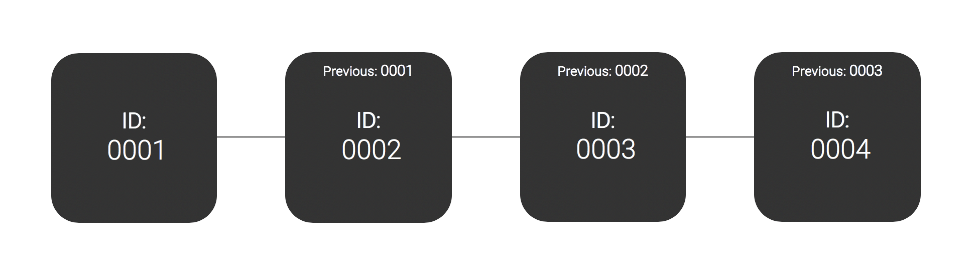
Linked Blocks
Each block is linked to one another, so if someone attempted to alter one, all of the blocks would be altered, which is impossible.

Slide 12
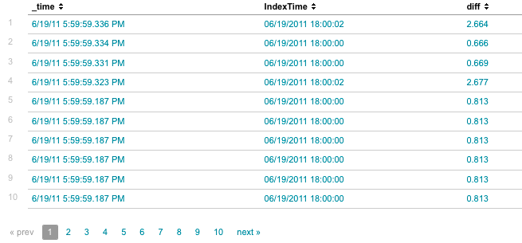
Timestamps
Tell you how, when, what, who, etc. about a transaction
There are rules and constraints with timestamps in blockchain
“Transactions must be in order or less than a 5 hour difference”
Comparable to file information

Slide 13

Synchronization
Constant synchronization on every server/machine partaking in ledger

Slide 14
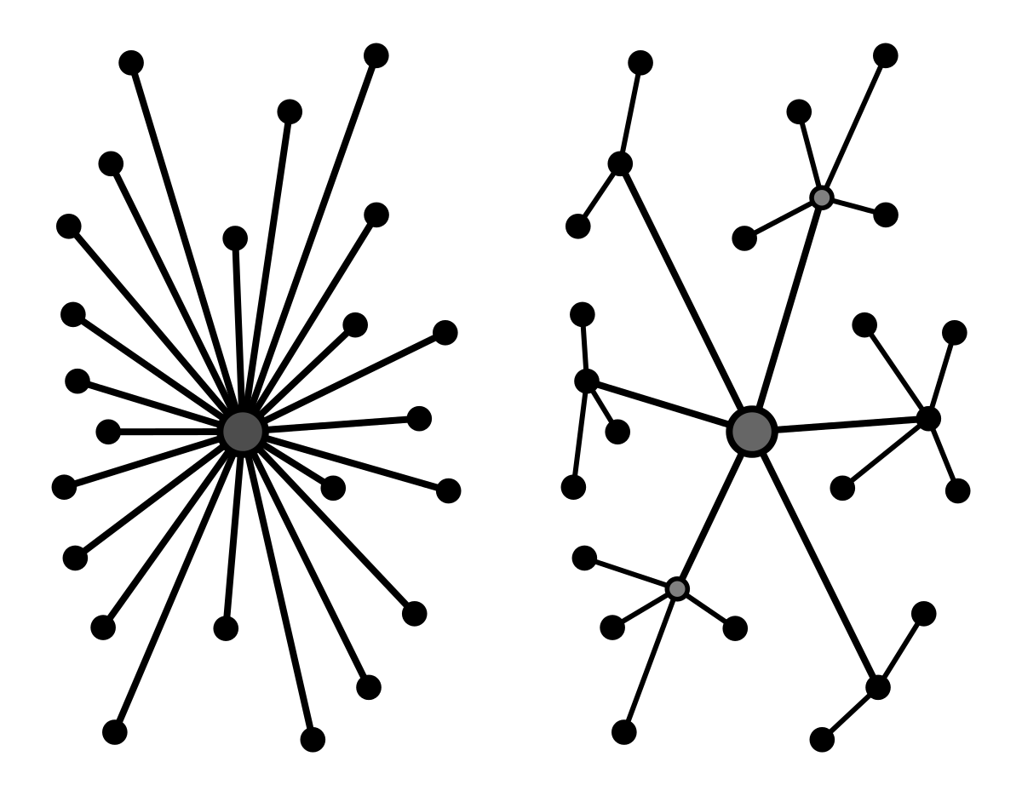
Decentralized
“no central point of control”
“utilizes innovative consensus protocols across a network of nodes to validate transactions and record data in a manner that is incorruptible.”
Centralized
Decentralized
https://lisk.io/academy/blockchain-basics/benefits-of-blockchain/what-is-decentralization

Slide 15


Decentralized
Blockchains and ledgers can be permissioned to only allow certain people to access it
Still unable to add to the chain without consensus and cannot tamper with records due to encryption
Ripple, for example, only allows validated people to access the ledger, including but not limited to Microsoft, Massachusetts Institute of Technology, and WorldLink.

Slide 16
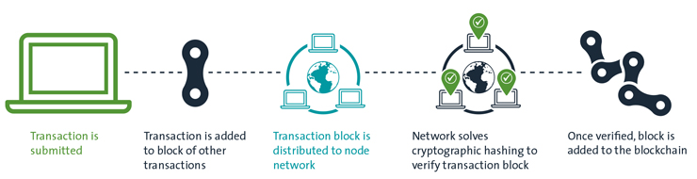
Automation
From a governance perspective, as ledgers actively match (and check) with distributed ledgers, the finished chain becomes a (balanced) shared perspective of all agreements between parties or in a network.
“The idea of a distributed database where *trust* (*authenticity of information*) is established through mass collaboration and clever code rather than through a powerful institution that does the authentication and the settlement…is the biggest innovation in computer science”.
-Don Tapscott, Tapscott Group CEO
All happens automatically

Slide 17
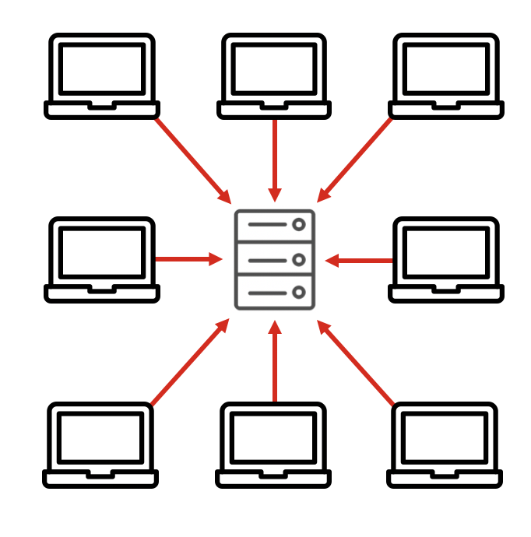
Fees
The main way we deal with a DoS (making network unavailable to users by flooding network) attack of legitimate-looking transactions is by raising transaction fees. If 51% of the network requires a specific transaction fee, you won't get a consensus if you don't pay it.
These fees scale drastically as the network load increases
The harder they attack, the more they must pay
DoS attacks seek to consume resources and attack the network
With a centralized system, it is much easier to overload a network

